Slide 1
Software Estimation Techniques
BITS Pilani
Viswanathan Hariharan
2015

Slide 2
Estimation techniques
Agenda
Introduction
Top down estimation
Bottom up estimation

Slide 3
Introduction
There are many estimation techniques such as
Expert judgement,
Estimation by analogy,
Delphi method,
etc.
However the most popular ones are
Top down &
Bottom up approaches

Slide 4
Bottom up estimation
For small projects (eg. 3 month project with 5 teams members) a bottom up approach is generally used
The project is decomposed into its activities, also known as Work Breakdown Structure (WBS)
For each activity, the effort is estimated

Slide 5
Example of Work Breakdown Structure (WBS)
Activity | Effort (person days)
User interface development
Design | 5
Coding | 15
Unit testing | 3
Business components development
Architecture design | 5
Detailed design
Inventory | 2
Purchase order | 2
Shipment | 2
Invoice | 2
Payment | 2
Coding & Unit testing
Inventory | 6
Purchase order | 6
Shipment | 6
Invoice | 6
Payment | 6
Integration testing | 10
System testing | 10
Deployment | 3
Total | 91

Slide 6
Bottom up estimation…
While estimating the effort for each activity, decompose the activity into smaller pieces
Instead of estimating a large activity, decompose it into smaller activities and estimate each small activity
All estimates have some errors - some are +ve errors and some –ve errors
When we have a large number of activities, these errors tend to cancel each other
This is called the “Law of large numbers”
Typically we need 5-10 numbers for the Law to apply

Slide 7
Top down estimation
In this technique, we first determine the size of the software
Example: Let us say an application has 25 screens and 10 reports. This gives a sense of the size of the software
We then convert the size into effort, based on historical data
Example:
Let us say, we have collected historical data on the effort per screen and report
Based on historical data, let us say , the average effort for developing one screen is 5 days
And let us say, the average effort for developing one report is 3 days
Then, the Total effort = 25 screens x 5 days + 10 reports x 3 days = 105 person days

Slide 8
Determining the size
Size can be determined in many ways, such as:
Use cases
Functions & data files
Objects – Screens, reports, etc.
Web pages
Test cases
Defects to be fixed
Configuration settings

Slide 9
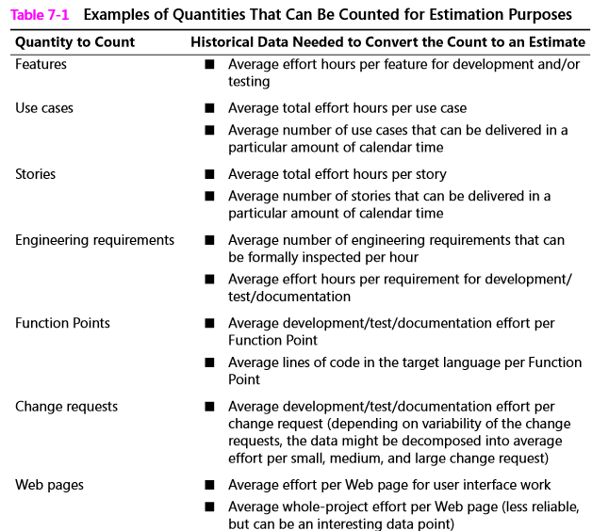
Example of historical data

Slide 10
Data collection
Collect effort for all activities and all items (screen, report, etc.) including
Requirement gathering
Architecture
Detailed design
Coding & Unit testing
Design of test cases
Integration testing
System testing
User acceptance testing
Project Management
User documentation
Reviews of requirement, design, code, test cases, user manual, etc.
Collect data while project is underway. It is difficult to go back six months in the project to try to collect data
If you do not have historical data, use data from current project, as a basis to estimate the remainder of the project

Slide 11
Calibration
Based on data collected, we can calibrate our productivity, ie. Effort for unit size
Calibration examples
Our team takes 8 hours for design & 24 hours to code one screen
Our testers take 6 hours to create a test case
Our maintenance team takes 4 hours to fix a defect

Slide 12
Factors influencing effort
Project size:
Project size has the biggest influence on effort estimation
Effort increases exponentially (not linearly) as project size increases because there is much more coordination in larger projects (this is opposite of ‘Economies of scale’ concept)
Kind of software being developed
Avionics, embedded systems and System software are much more complex than business systems and internet systems
Personal factors impact estimation
Capability of requirements analyst, capability of programmer, change of team members, level of domain knowledge, platform experience, team cohesion

Slide 13
Summary
We looked at 2 primary ways of estimating effort of software projects, namely, top down & bottom up
In top down approach
We count the number of items to determine the size of software
We then convert the size into effort based on historical data
Bottom up approach is used for small projects
Here we use work breakdown structure (WBS) to identify different activities
We then estimate the effort for each activity

